Slide 1
DDCA MINI PROJECT
Design and Simulation of a
Smart Home Security System
Digital Design and Computer Architecture
LOCK
Team Members: Vayyala Dhikshitha – 2620030310
Neerukonda Charishma Chowdari – 2620030311
Yuthikaa Bellamkonda -
Section: Section - 2
Faculty: Dayarnab
COMBINATIONAL LOGIC • LOGISIM

Slide 2
Problem Statement & Objective
2/7
PROBLEM STATEMENT
CONCEPTUAL BLOCK DIAGRAM
A home security system should detect possible intrusion and activate an alarm only when the system is armed.
Door Sensor
OBJECTIVES
Window Sensor
LOGIC
SYSTEM
ALARM
Detect door opening
Detect window opening
Motion Sensor
Detect motion
Activate alarm only when security is armed
Implement using basic logic gates
Security System
Simulate and verify in Logisim
Sensor signals → Boolean logic → Alarm output

Slide 3
System Inputs, Output and Boolean Expression
3/7
Signal
Meaning
0
1
BOOLEAN EXPRESSION
S
Security system
Disarmed
Armed
A = S(D + W + M)
D
Door sensor
Closed
Open
W
Window sensor
Closed
Open
M
Motion sensor
No motion
Motion detected
HOW IT WORKS
OR: any intrusion sensor is active
A
Alarm output
OFF
ON
AND: alarm activates only when armed
A = S AND (D OR W OR M)
Alarm is ON only if S = 1 and at least one sensor is active.

Slide 4
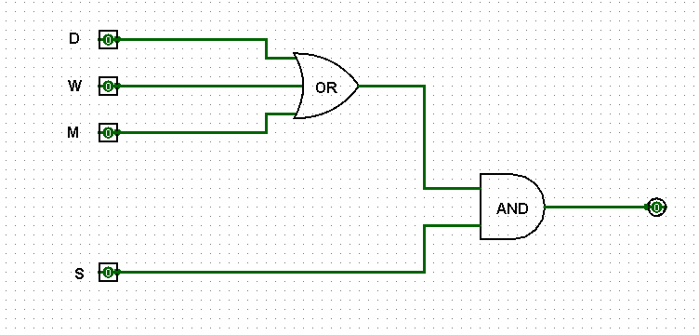
Combinational Logic Circuit
4/7
LOGIC STRUCTURE
D — Door
W — Window
OR
AND
M — Motion
Alarm A
3-input OR
S — Security
CIRCUIT COMPONENTS
One 3-input OR gate and one 2-input AND gate
Four input switches (S, D, W, M) and one output LED

Slide 5
Truth Table & Logic Verification
5/7
S
D
W
M
A
0
0
0
0
0
Boolean expression
0
0
0
1
0
0
0
1
0
0
A = S(D + W + M)
0
0
1
1
0
0
1
0
0
0
0
1
0
1
0
When S = 0, the alarm is always OFF.
When S = 1, any active sensor turns it ON.
0
1
1
0
0
0
1
1
1
0
1
0
0
0
0
1
0
0
1
1
Highlighted rows: Alarm = 1
1
0
1
0
1
1
0
1
1
1
1
1
0
0
1
1
1
0
1
1
1
1
1
0
1
1
1
1
1
1

Slide 6
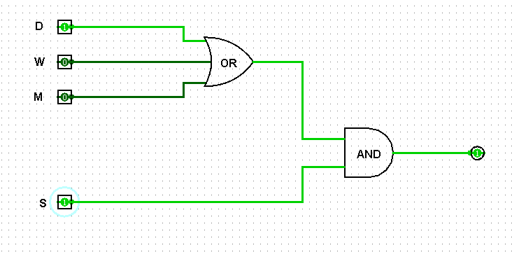
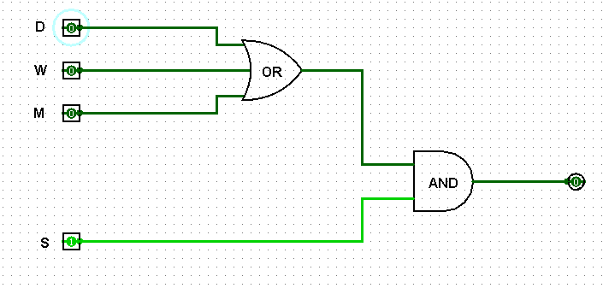
Logisim Simulation and Test Cases
6/7
Test the input switches and confirm that the LED matches the expected alarm state.
Case
S
D
W
M
Expected A
1
0
1
0
0
0
2
1
1
0
0
1
＋
INSERT LOGISIM
SIMULATION SCREENSHOT HERE
3
1
0
1
0
1
4
1
0
0
1
1
5
1
0
0
0
0
SIMULATION CHECKLIST
＋
INSERT SECOND SCREENSHOT
SHOWING ALARM ON
Case 1: disarmed → alarm OFF
Cases 2–4: armed + intrusion → alarm ON
Case 5: armed + no intrusion → alarm OFF

Slide 7
Conclusion & Future Scope
7/7
CONCLUSION
FUTURE SCOPE
Designed a combinational smart home security system.
Add multiple security zones.
Used basic OR and AND logic gates.
Add password/keypad-based activation.
Implemented A = S(D + W + M).
Add buzzer and visual indicators.
Truth table and Logisim tests verify expected output.
Connect the logic system to real sensors.
Demonstrates a practical application of digital logic.
Explore IoT-based extensions as future work.
THANK YOU

